Slide 1






40min
REST JWT Postman DevTools
Theoretical
Introduction
QA Event
Notes:
REST: Representational state transfer

Slide 2




MENU
Chrome DevTools
DEMO
REST
Methods
Status Codes
JWT
Postman
Alternatives
DEMOS

Slide 3
DevTool Tabs
Open with F12
Elements
Console
Network
Application
Redux (plugin)
Notes:
Elements:
Overview of the HTML, CSS etc
Console:
Not all errrors may be shown in the UI, but all errors typically do end up in the console. It’s a good idea to create a bug for any error that shows up there, even if the application did seem to behave as expected.
Network:
Our focus for today. Listen in on the communication with the backend.
Application:
Cookies & stuff. This is important today because the JWT is typically stored in Application > Storage > Session Storage.
Redux:
This is a plugin that needs to be installed from the Chrome Web Store. (https://chrome.google.com/webstore/detail/redux-devtools/lmhkpmbekcpmknklioeibfkpmmfibljd?hl=en)
It only works if the developers have used Redux – if the frontend is built using Angular or React, chances are they have.
For some cases, it can be used as an alternative for doing a SQL query. Check the current application state.

Slide 4



Chrome DevTools
The Tabs
DEMO
Notes:
DevTools:
Docking possibilities
Device Toolbar (dimensions & throttling)
Elements:
In the regex session one of the exercises was extracting the data from a table from a Wikipedia page – to copy the table (https://en.wikipedia.org/wiki/Regular_expression#POSIX_basic_and_extended)
During the security bootcamp this tab was used to become Portal Administrator.
!! DEMO ENDS WHEN:
As soon as you want to expand a little on the http Methods & Response Status Codes

Slide 5



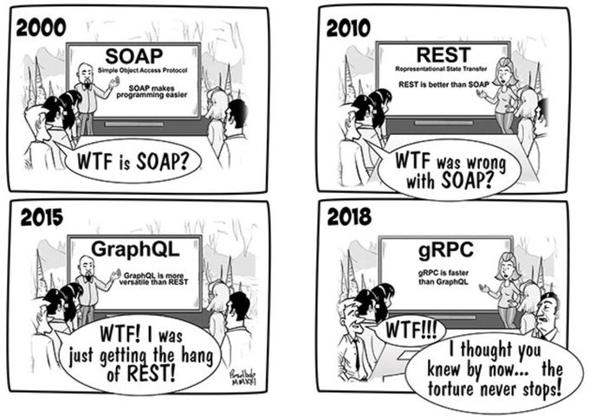

REST?

Slide 6



Methods
GET
POST
PUT
PATCH
DELETE
OPTIONS
Notes:
Other: HEAD, CONNECT, TRACE
Details: https://developer.mozilla.org/en-US/docs/Web/HTTP/Methods

Slide 7

Response Status Codes
1xx – Informational
2xx – Success
3xx – Redirection
4xx – Client errors
5xx – Server errors

Slide 8
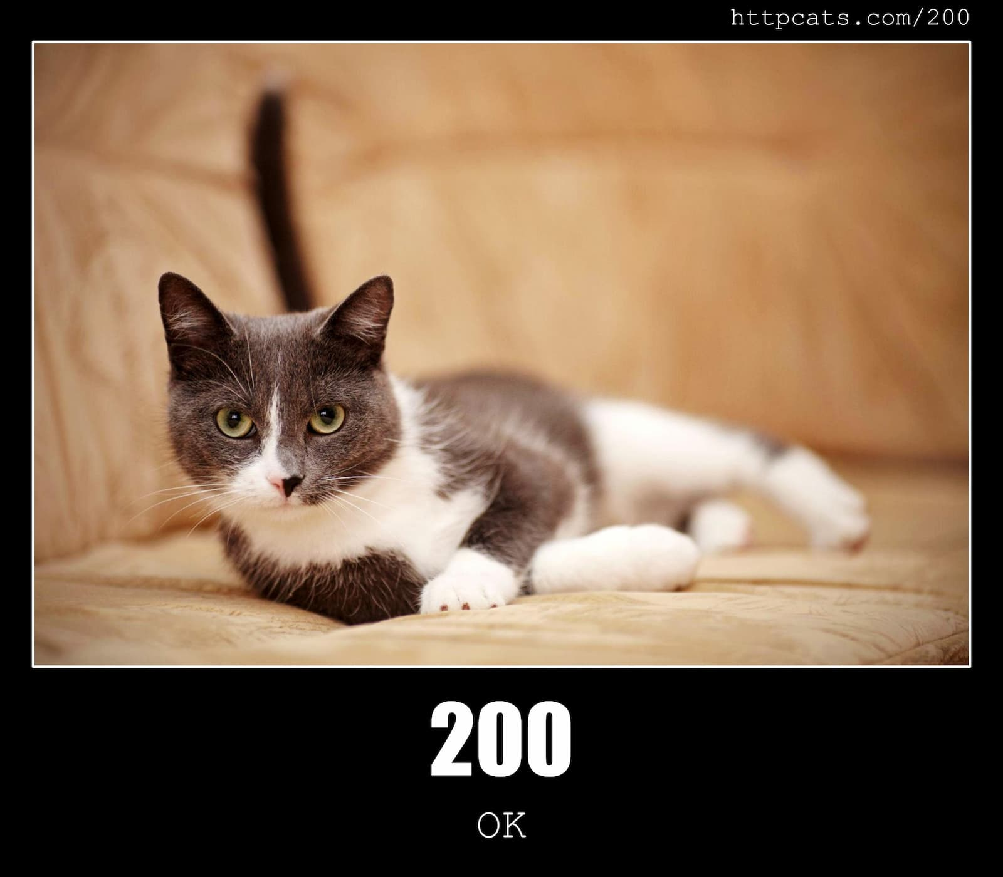
Common Status Codes
Notes:
Website: https://httpcats.com/

Slide 9
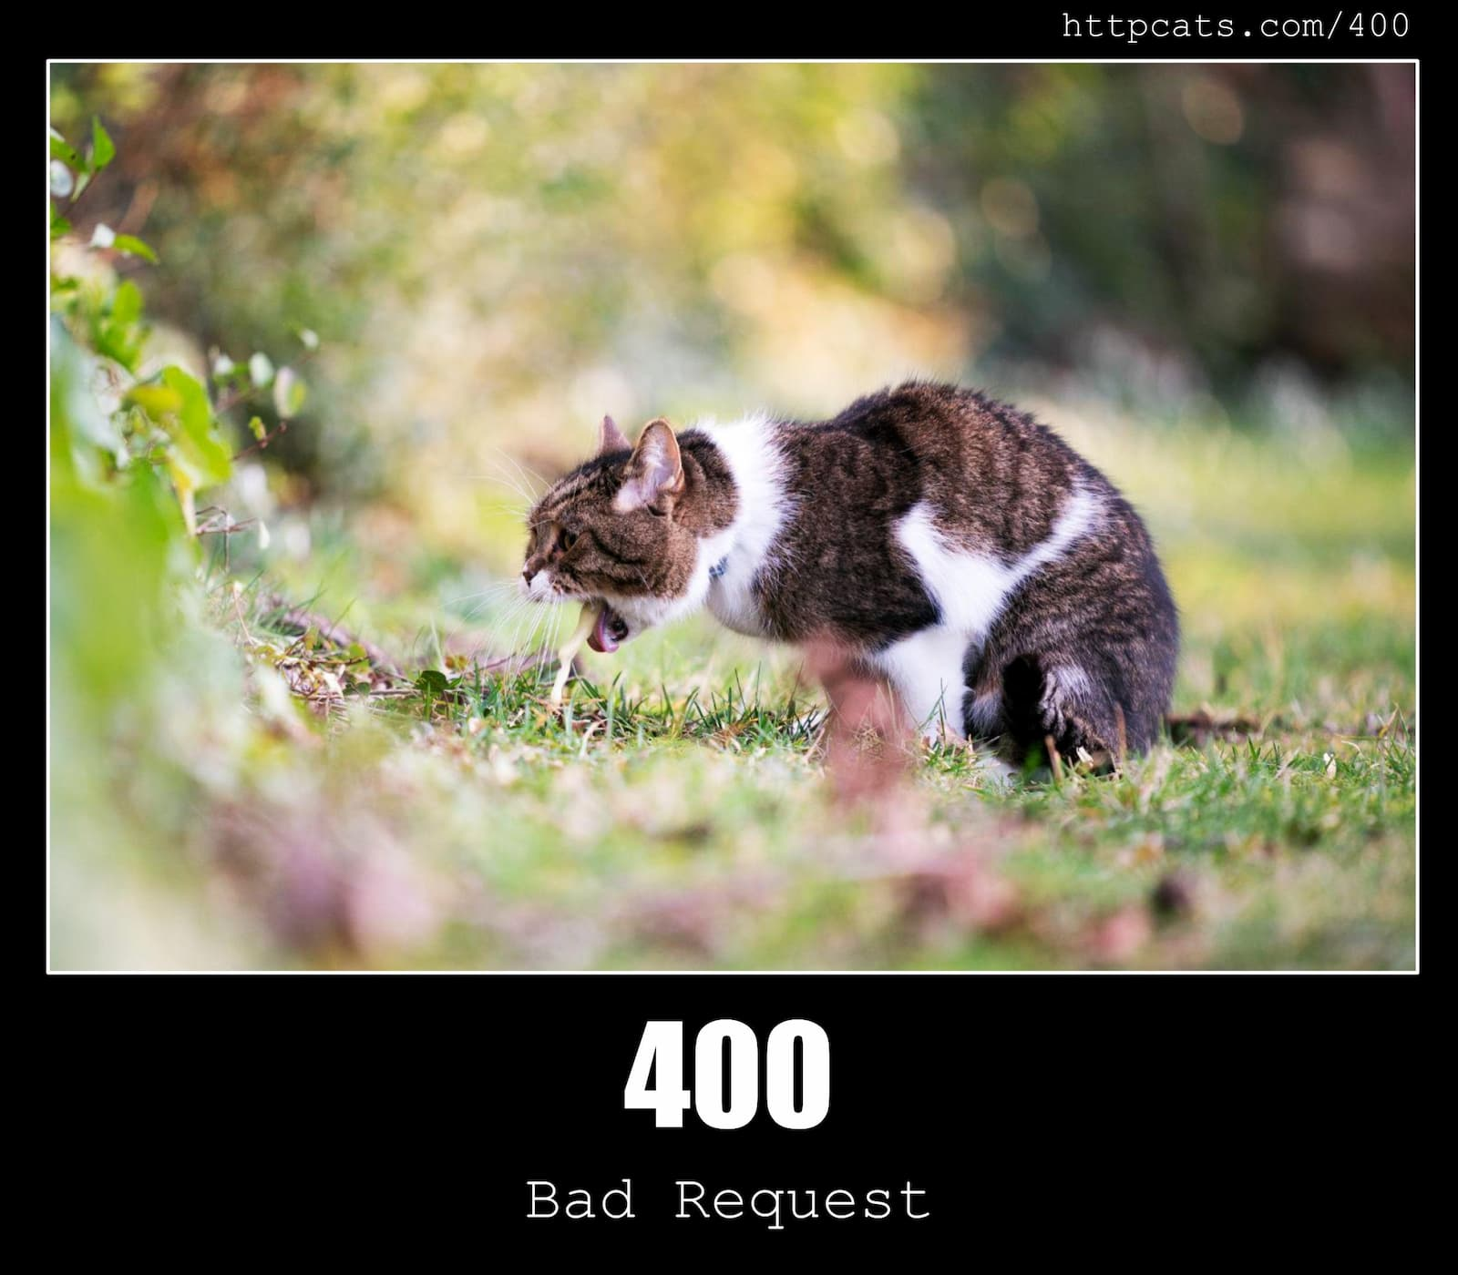
Common Status Codes

Slide 10
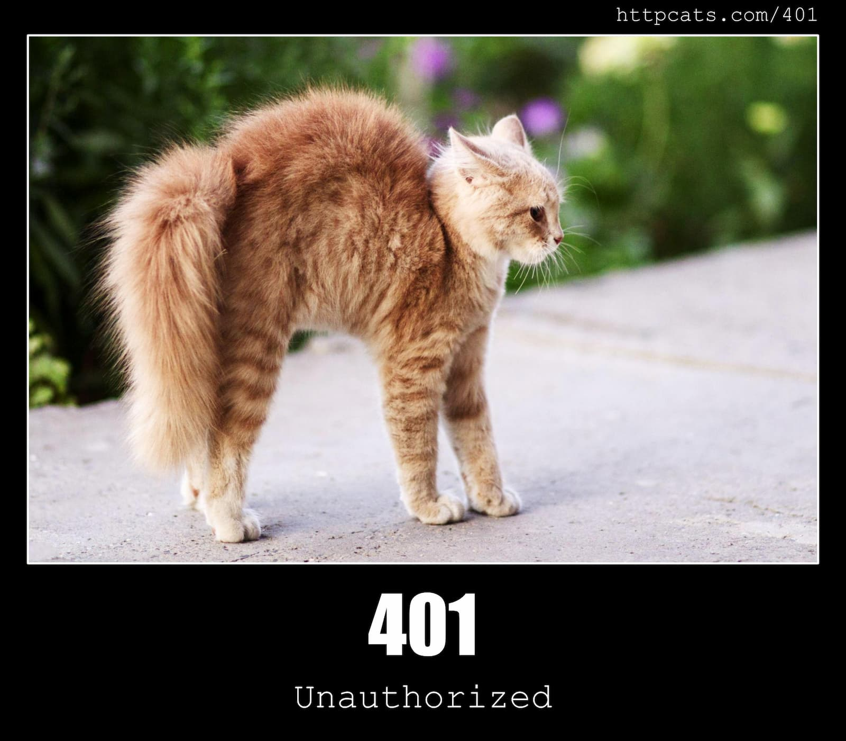
Common Status Codes

Slide 11
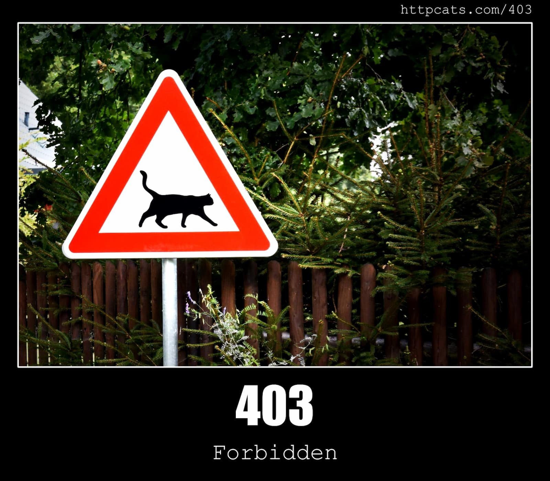
Common Status Codes

Slide 12
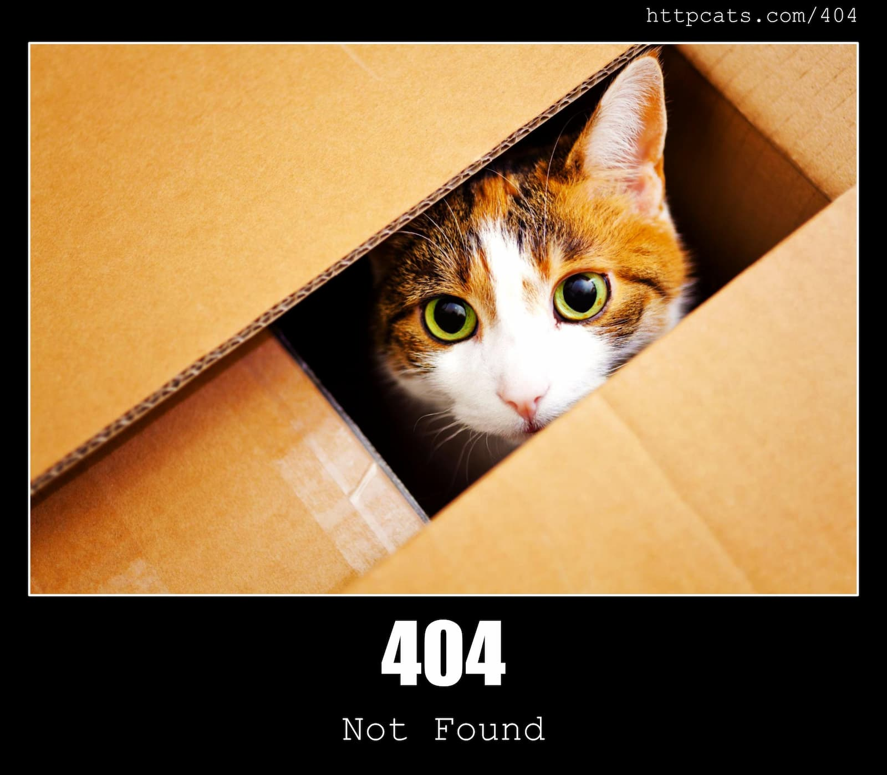
Common Status Codes

Slide 13
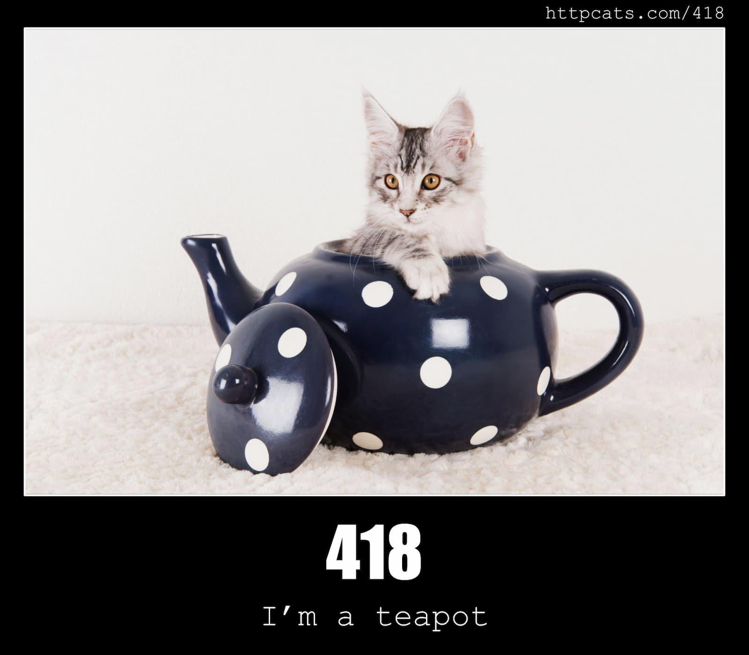
Common Status Codes
Notes:
April Fools’ joke in 1998 & 2014

Slide 14
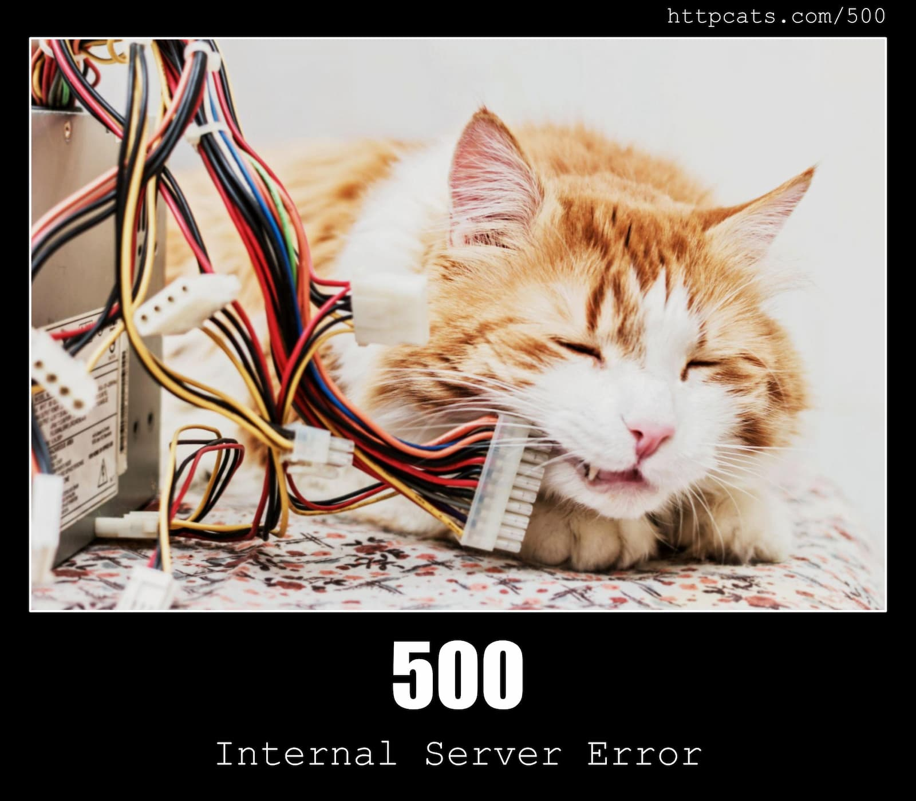
Common Status Codes

Slide 15


Common Status Codes
200 – OK
400 – Bad Request
401 – Unauthorized
403 – Forbidden
404 – Not Found
500 – Internal Server Error
Notes:
100 Continue, 101: Switching Protocols, 102 Processing
201 Created, 202 Accepted, 204 NoContent, 206 Partial Content
300 Multiple Choices, 301 Moved Permanently, 302 Found, 303 See Other, 304 Not Modified, 307 Temporary Redirect, 308 Permanent Redirect
405 Method Not Allowed, 406 Not Acceptable, 408 Request Timeout, 409 Conflict, 411 Length Required, 413 Payload Too Large, 414 URI Too Long, 429 Too Many Requests
List: https://developer.mozilla.org/en-US/docs/Web/HTTP/Status

Slide 16


Postman… or not…
cURL
SoapUI
hoppscotch.io
Insomnia
VSCode: Thunder Client

Slide 17



Postman
Hoppscotch
Thunder Client
DEMO
Notes:
DEMO: Postman, Hoppscotch.io & Thunder Client
NOT TO FORGET:
Autohotkey scripts for Chrome & JWT helpers
JWT: jwt.io, base64decode & Autohotkey

Slide 18



THANK YOU!

Slide 19
WiFi: itenium-guest / Wifi4Ufree

